Slide 1
Z3 Internals
Nikolaj Bjørner, Microsoft Research, RiSE
Clemens Eisenhofer, TU Wien
Nuno P Lopes, U Lisbon
POPL tutorials, January 16, 2023

Slide 2
Tutorial road-map
Theory Solvers
What to expect when expecting z3?
Quantifiers
Interfacing with z3
Use case
Solver Internals
Tactics
Use case
Solver Engines - CDCL(T)

Slide 3
Material
z3 source on GitHub https://github.com/z3prover/z3
Online guide https://microsoft.github.io/z3guide
Tutorial document https://z3prover.github.io/papers/z3internals.html

Slide 4

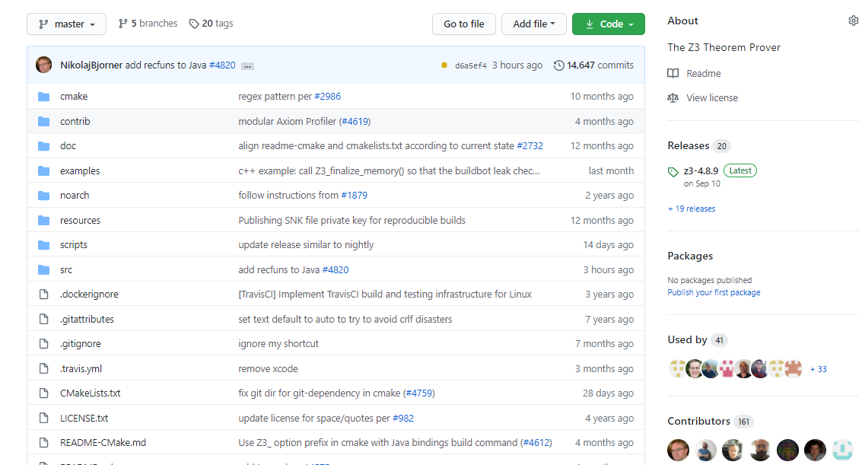
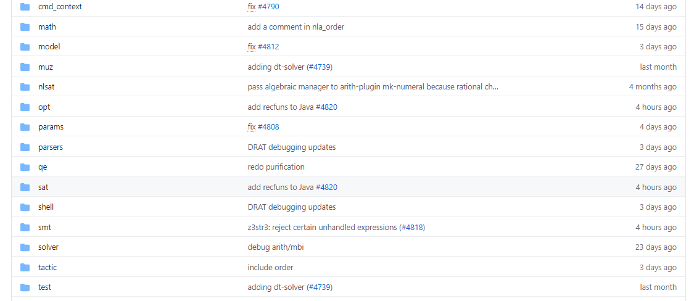
on GitHub
Scope of this tutorial

Slide 5
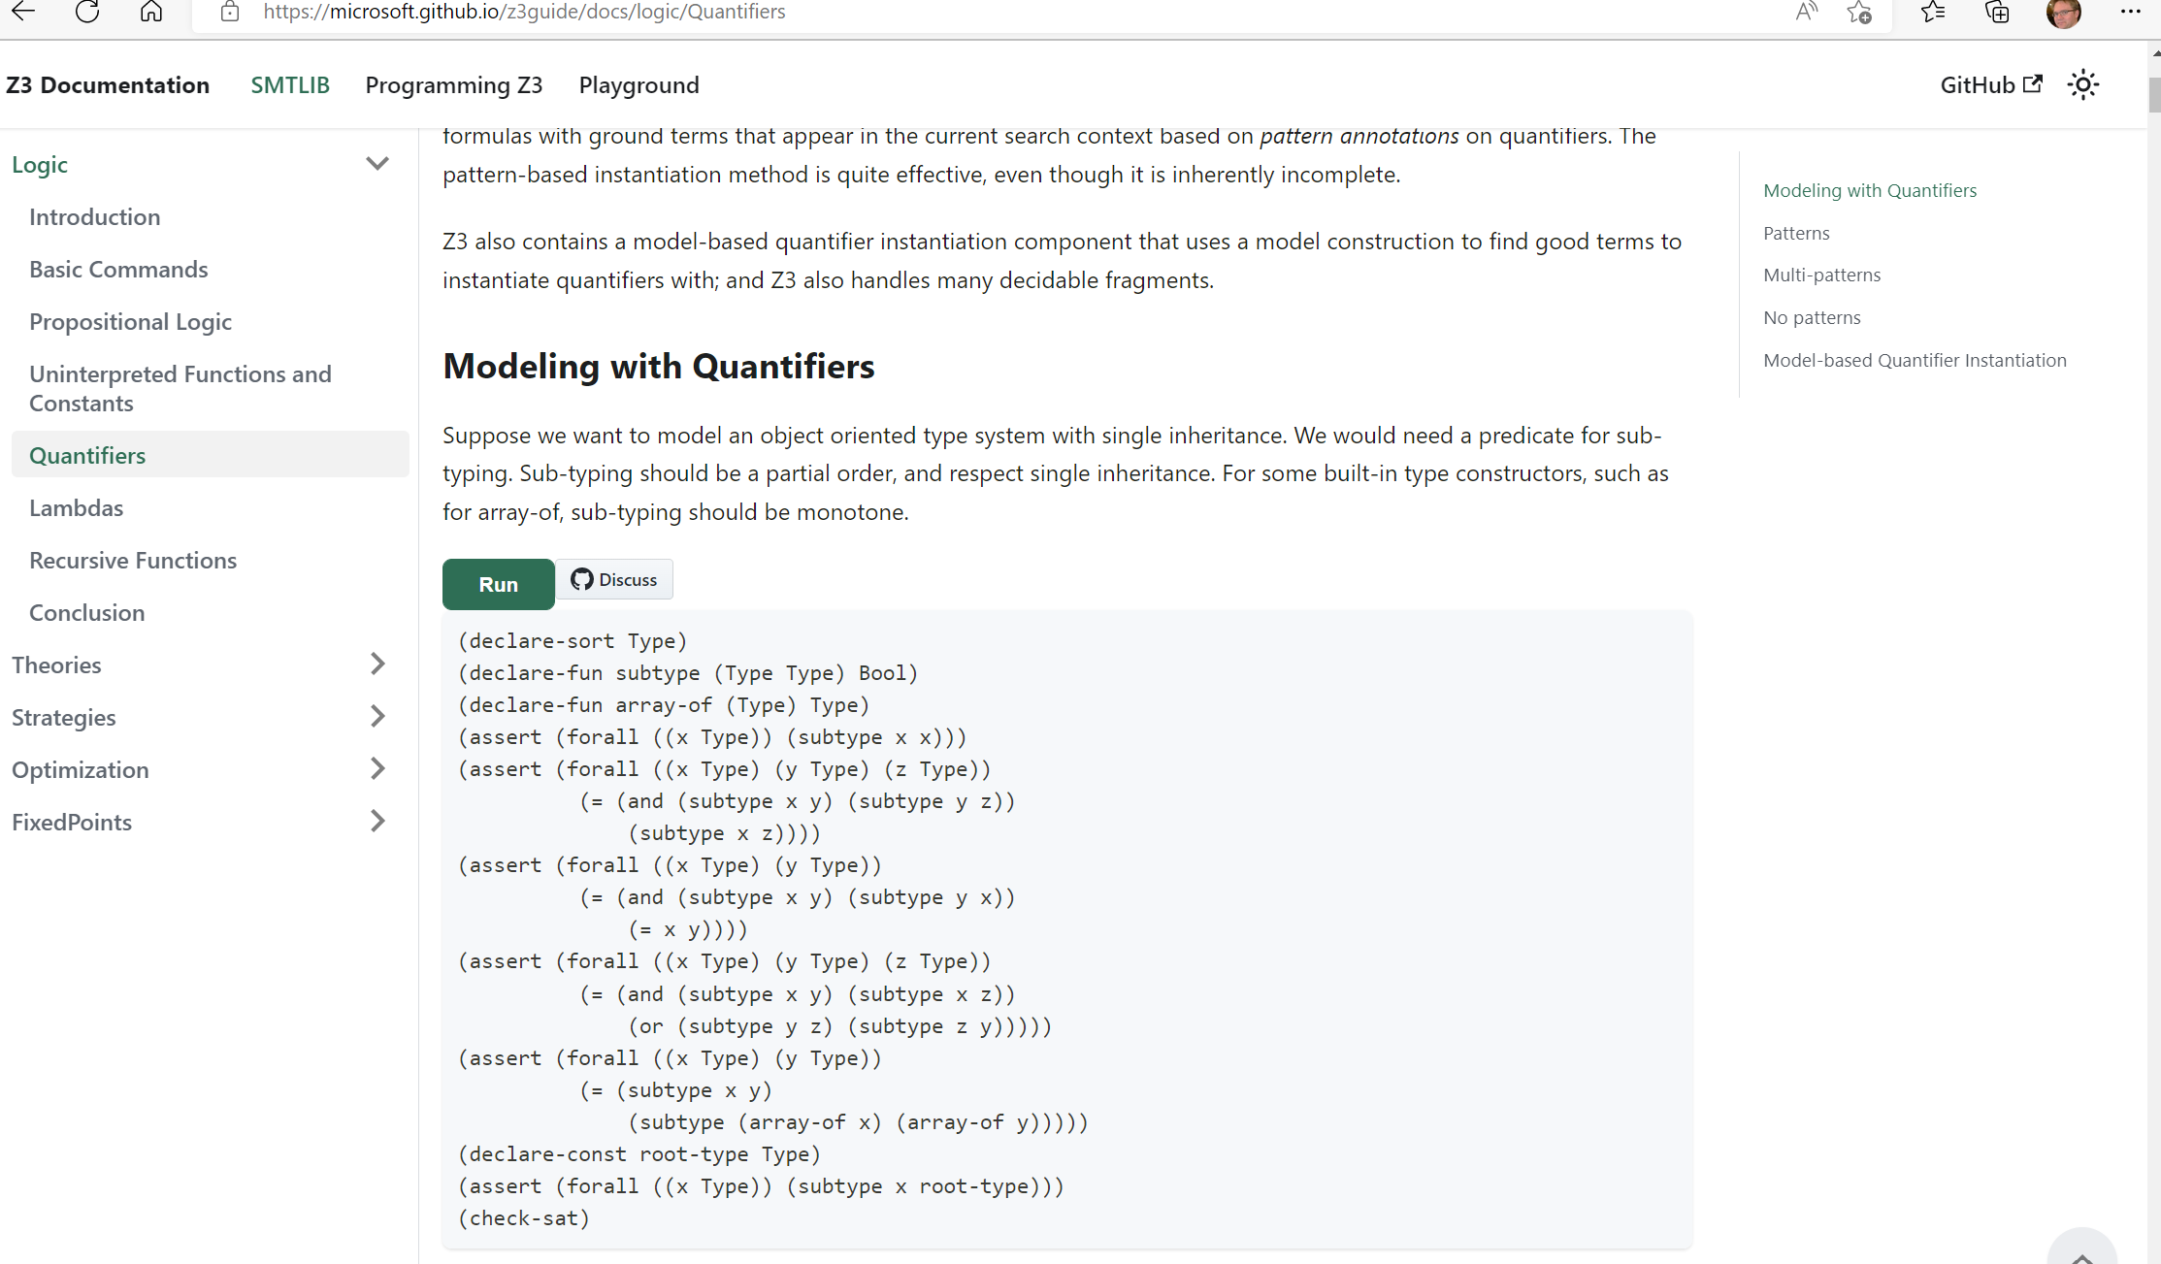
Online guide

Slide 6
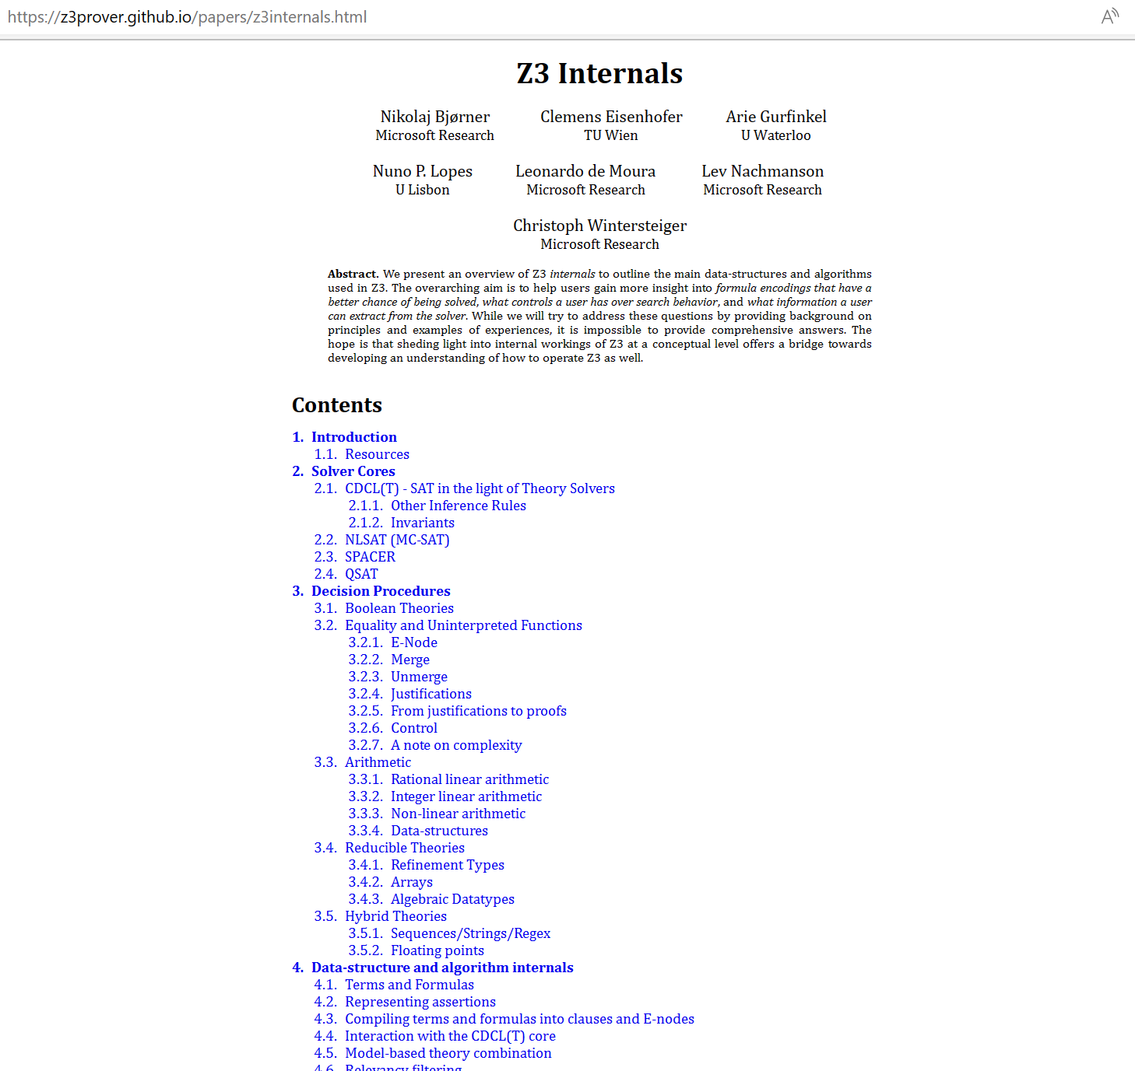
Tutorial document

Slide 7
What to expect when expecting a z3 internals tutorial?

Slide 8



What (some) users want to learn
How can I tune formulas to be solved by Z3?
What features of Z3 should I use for solving formulas?
Can I control the output of Z3
models (to be diverse, random)?
How can I have Z3 provide feedback on solving?
How can I determine which strategies apply to my formulas?

Slide 9
What a developer likes to talk about
Solvers
Algorithms
Data-structures
Logic features
Proof systems
Heuristics
Anatomy of Congruence Closure
How do solvers interact (with the core)?
How do solvers implement search?

Slide 10
Tutorial setup
Exploring Z3 Concepts with use cases
Understand Solver Internals

Slide 11
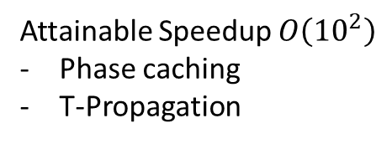
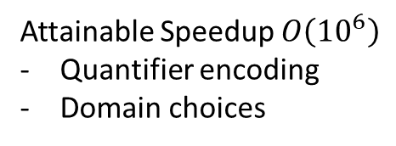
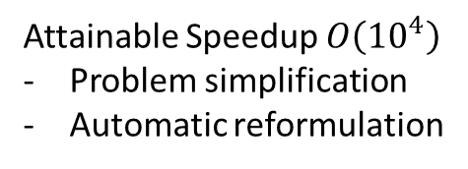
Encodings, Pre-processing, Search
Encoding
Attainable Speedup $O\left({10}^{6}\right)$
Quantifier encoding
Domain choices
New
Theory solver
Pre-processing (Tactics)
Attainable Speedup $O\left({10}^{4}\right)$
Problem simplification
Automatic reformulation
Advances in Search
Attainable Speedup $O\left({10}^{2}\right)$
Phase caching
T-Propagation
Thanks to D.O.F. Pons

Slide 12
Interfacing with Z3
Some anecdotal experiences

Slide 13
Efficiency
Scale
Technology Landscape
Propositional
Satisfiability Solving
SAT
Breakthroughs in 2000s
Cheap local Inferences
Garbage collect useless clauses
Hardware Design
Automation
Breakthroughs late 2000s
SAT + global inferences +
global propagators
Mixed Integer
Programming
MIP
Breakthroughs in 1960s
Harnessed since 1990s
LP: global Inferences
IP: Cuts, Branch and Bound
Satisfiability Modulo Theories
Operations
Research
CP-SAT
SMT
Z3
Constraint
Programming
Software Development +…
CP
Breakthroughs since 1990s
Powerful domain-tailored
global propagators
Expressive Power

Slide 14

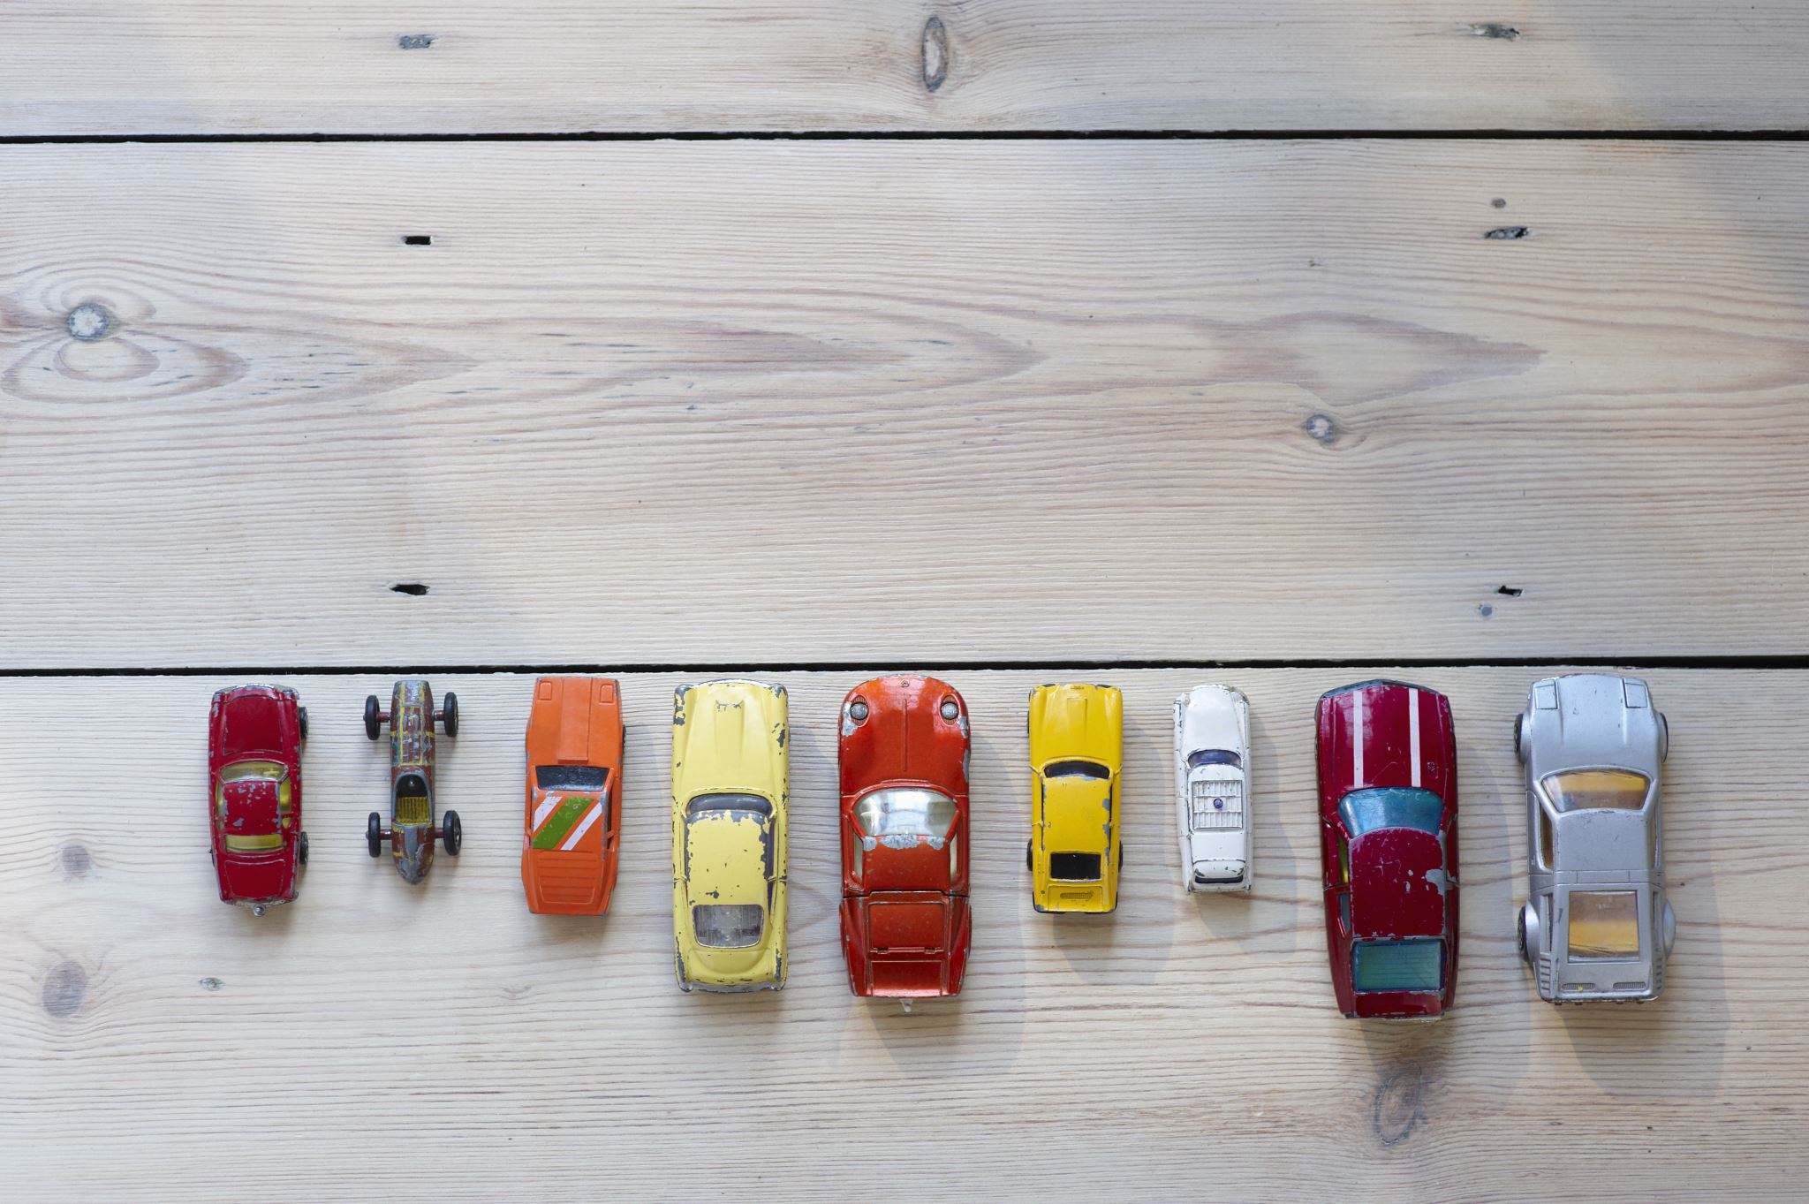


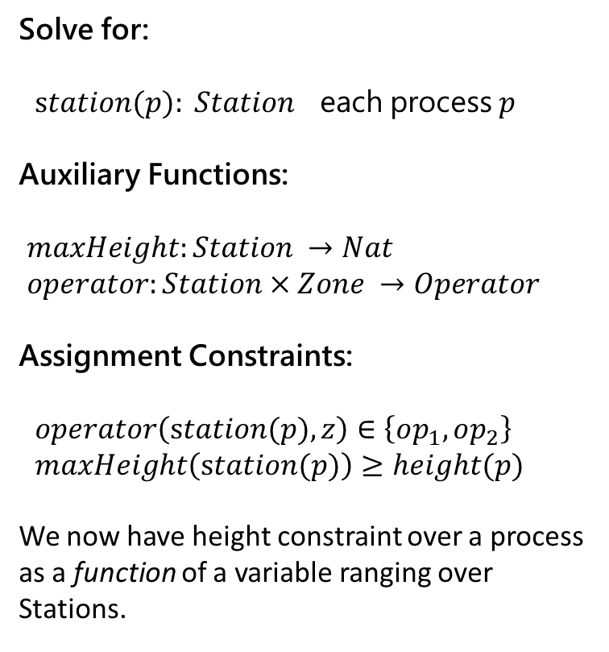
Encoding – A case study
Solve for:
$station(p): Station$ each process $p$
Auxiliary Functions:
$maxHeight:Station →Nat$
$operator:Station×Zone →Operator$
Assignment Constraints:
$operator\left(station(p),z\right)∈\left\{op_{1},op_{2}\right\}$
$maxHeight\left(station(p)\right)≥height(p)$
We now have height constraint over a process as a function of a variable ranging over Stations.
Process
Task 1
Task 2
Task 3
Task 4
Task 5
Task 6
Process
Task 1
Task 2
Task 3
Task 4
Task 5
Task 6
Process
Task 1
Task 2
Task 3
Task 4
Task 5

Slide 15
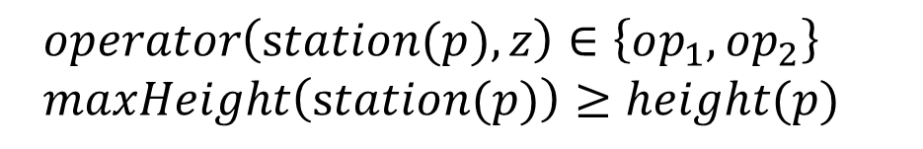
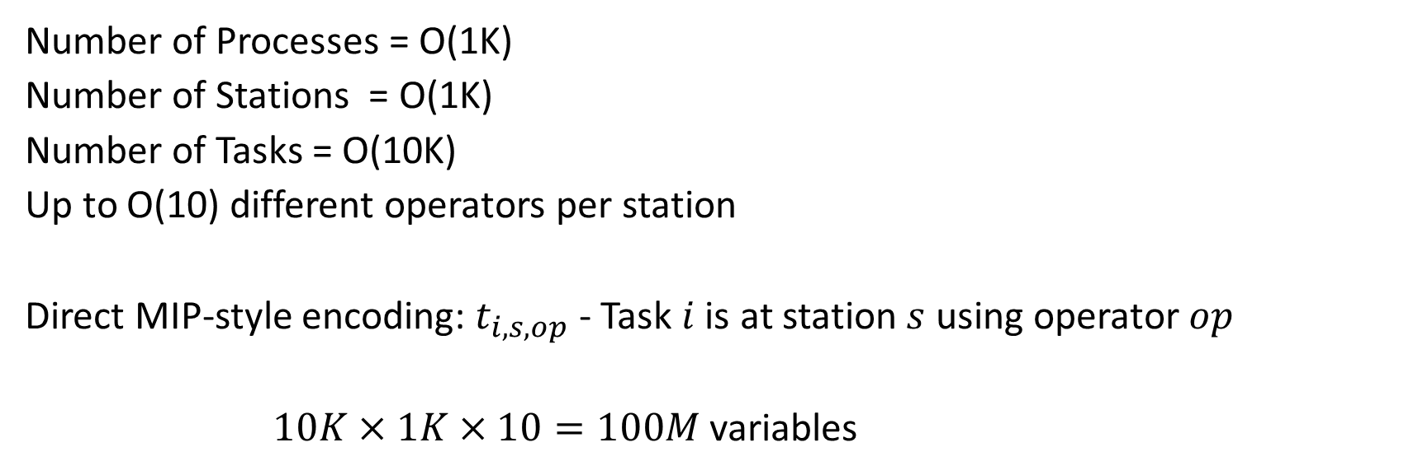
Encoding - Domain Overload
Number of Processes = O(1K)
Number of Stations = O(1K)
Number of Tasks = O(10K)
Up to O(10) different operators per station
Direct MIP-style encoding: $t_{i,s,op}$ - Task $i$ is at station $s$ using operator $op$
$10K×1K×10=100M$ variables
SMT approach: Use uninterpreted functions for “symbolic indices”
$operator\left(station(p),z\right)∈\left\{op_{1},op_{2}\right\}$
$maxHeight\left(station(p)\right)≥height(p)$

Slide 16
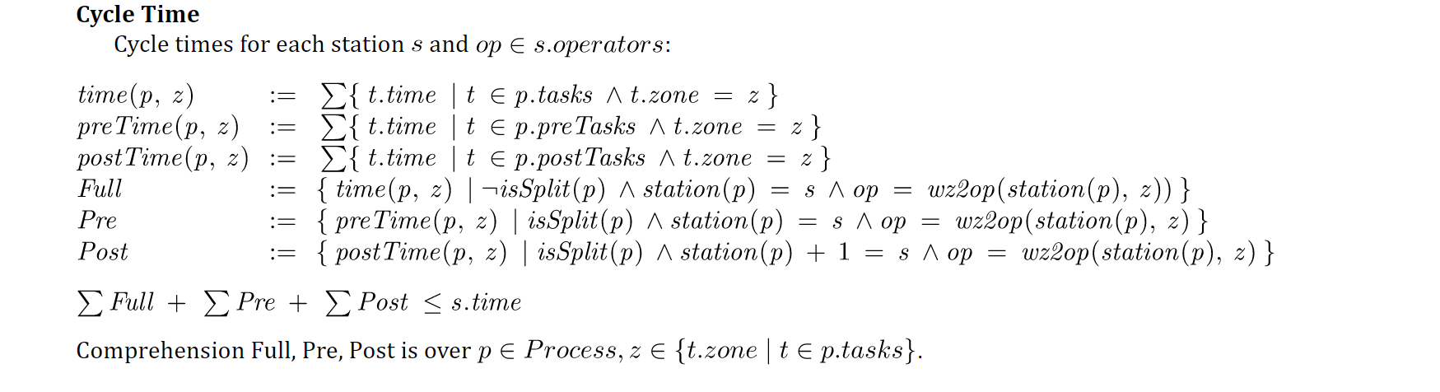
Encoding - Constraint Overload
a polluting, nasty side constraint
Constrained multi-knapsack:
A set of items, each is added to one knapsack, subject to side-constraints
Z3 approach: Programming Custom Theories (no built-in scheduling constraints)

Slide 17
Encoding – A humble path of discovery
v1: Pre-solving
Assign a small batch of 4-10 processes to stations at a time
v2: Pre-solving take two
Assign just one process at a time and only encode process constraints when a process gets assigned.
The resulting solver can assign 950 out of 1050 processes in a few minutes.
v3: A custom CDCL / CSP solver
Perform branching and propagation of cycle time constraints on top of repeated calls to Z3.
Maintain backtracking stack and add lemmas based on the chosen branches.
This was complex to engineer and only exercised in preliminary form.
v4: with Custom Propagator and Bit-vectors
With bit-vectors, without cycle-time: solvable in 30 seconds.
With bit-vectors and cycle-time: solvable for 300 processes in a few minutes, but not all processes.
With bit-vectors, programmable-propagator for cycle-time: patching + solving
Stations and processes, station heights and task time are integers
Solved 100 processes very slowly.
Initial: a few hours
Current: a few minutes.

Slide 18
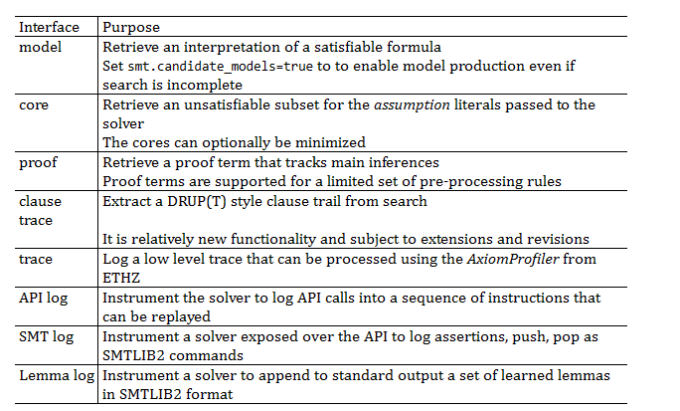
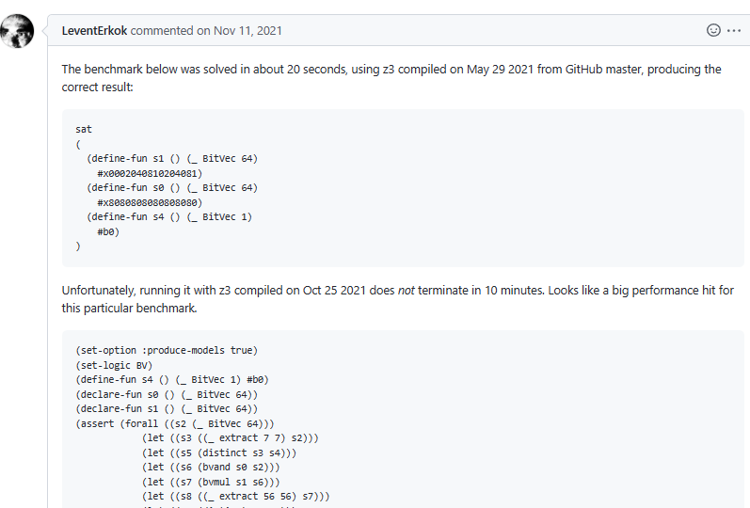
Retrieving Information
A case study in tuning z3

Slide 19
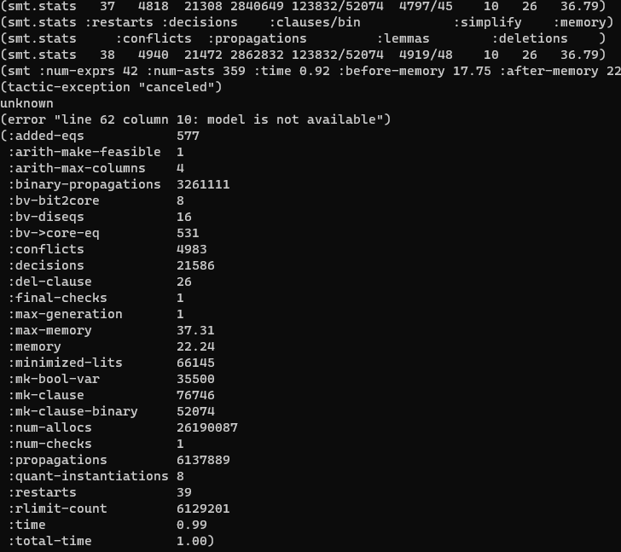
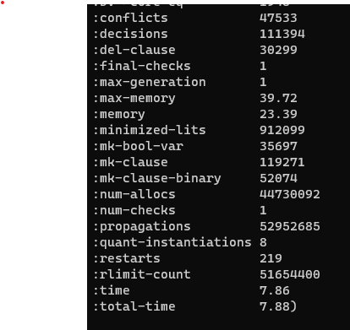
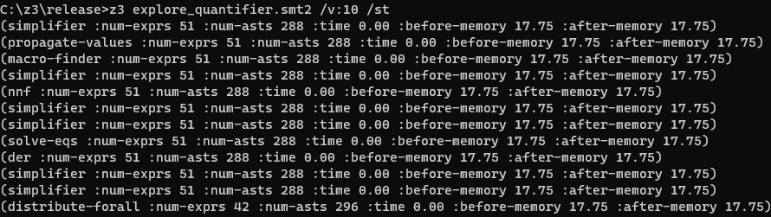
Retrieving Information – for diagnostics
Conflicts grow, but no new quantifier instantiations
First attempt
Run verbose
Get statistics
Very few quantifier instantiations

Slide 20
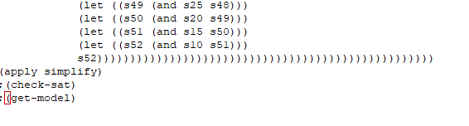
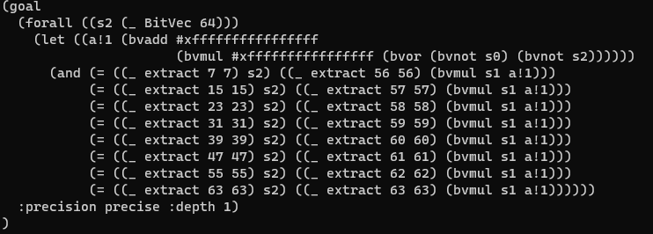
Retrieving Information
So lots of conflicts. No quantifier instantiations.
Stuck with multiplier reasoning?
What formula is being solved?
Where does this funny
-1 – 1*(s0 | s2) come from?
It’s a regression. New rewrite rule that is harmful to solver!
~x = -1 – 1*x

Slide 21
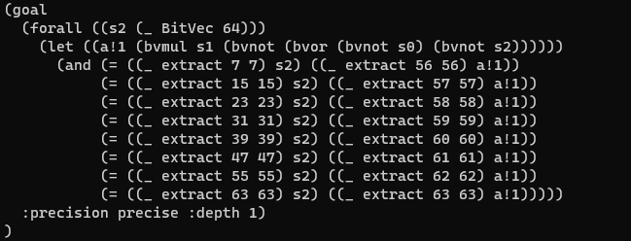
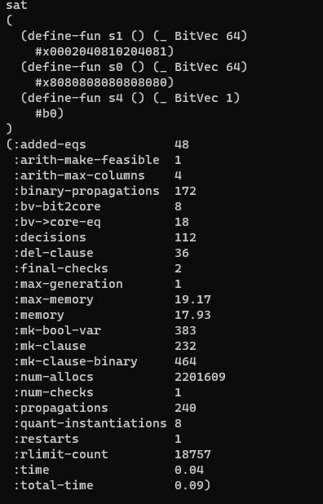
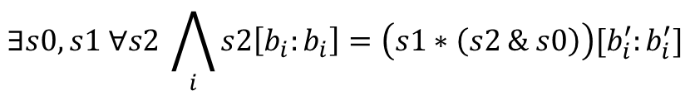
Retrieving Information
Funny rewrite, reverted
It is solved immediately
$$∃s0,s1 ∀s2 \bigwedge_{i}{s2\left[b_{i}:b_{i}\right]=\left(s1∗\left(s2 \& s0\right)\right)[b_{i}^{′}:b_{i}^{′}]}$$

Slide 22
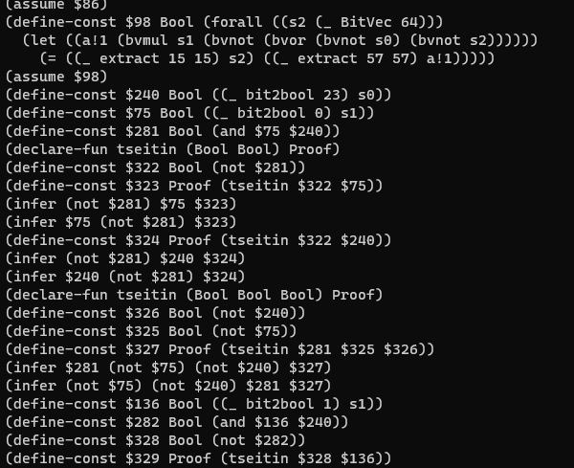
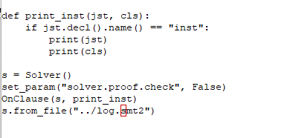
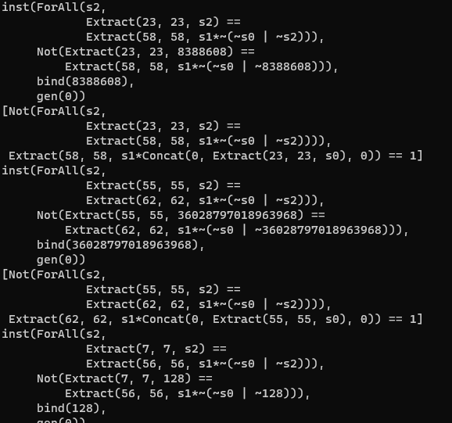
Retrieving Information – what are the inferences? (preview of clause logs)
Log is not readable by itself
But I can write a script to filter through log
It prints instances in Z3’s Python format

Slide 23
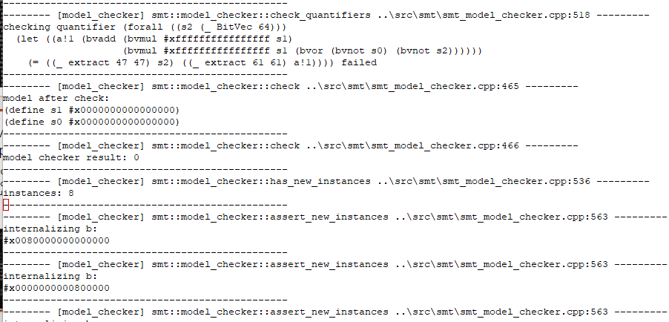
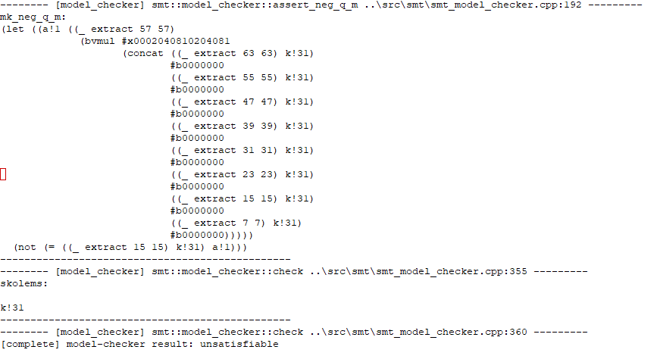
Retrieving information – “I program z3 and I have no life version”
Where does it get stuck?
-tr:model_checker – debug trace what does MBQI do?
Last MBQI check-sat call
(with fix)
Second to last call
(without fix)

Slide 24
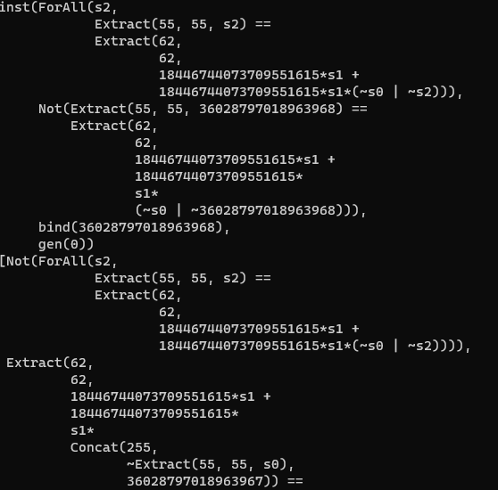
Retrieving information – “I program z3 and I have no life version”
Instances
(without fix)
Instances
(with fix)
Much cheaper for bit-blasting!

Slide 25
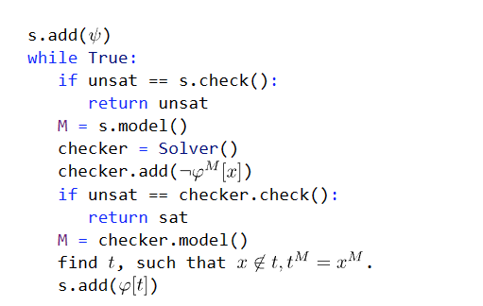
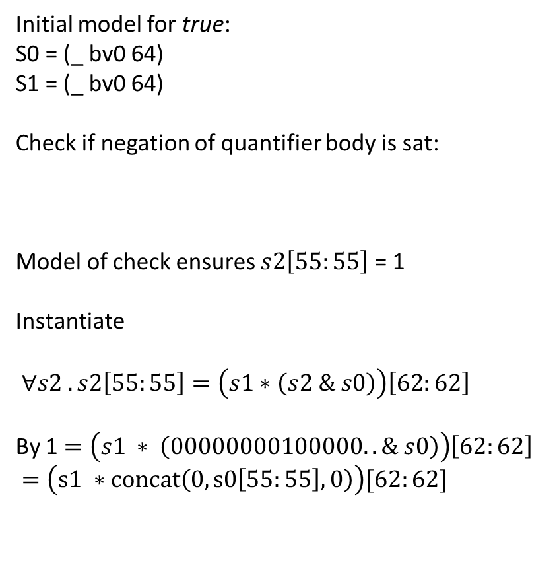
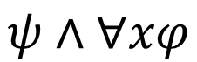
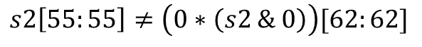
Retrieving information
Initial model for true:
S0 = (_ bv0 64)
S1 = (_ bv0 64)
Check if negation of quantifier body is sat:
Model of check ensures $s2\left[55:55\right]$ = 1
Instantiate
$∀s2 . s2\left[55:55\right]=\left(s1∗\left(s2 \& s0\right)\right)\left[62:62\right]$
By 1 $=\left(s1 ∗ \left(00000000100000.. \& s0\right)\right)\left[62:62\right]$
$=\left(s1 ∗concat\left(0, s0\left[55:55\right],0\right)\right)[62:62]$
How does MBQI work?
$$ψ∧∀xφ$$
$$s2\left[55:55\right]≠\left(0∗\left(s2 \& 0\right)\right)[62:62]$$

Slide 26
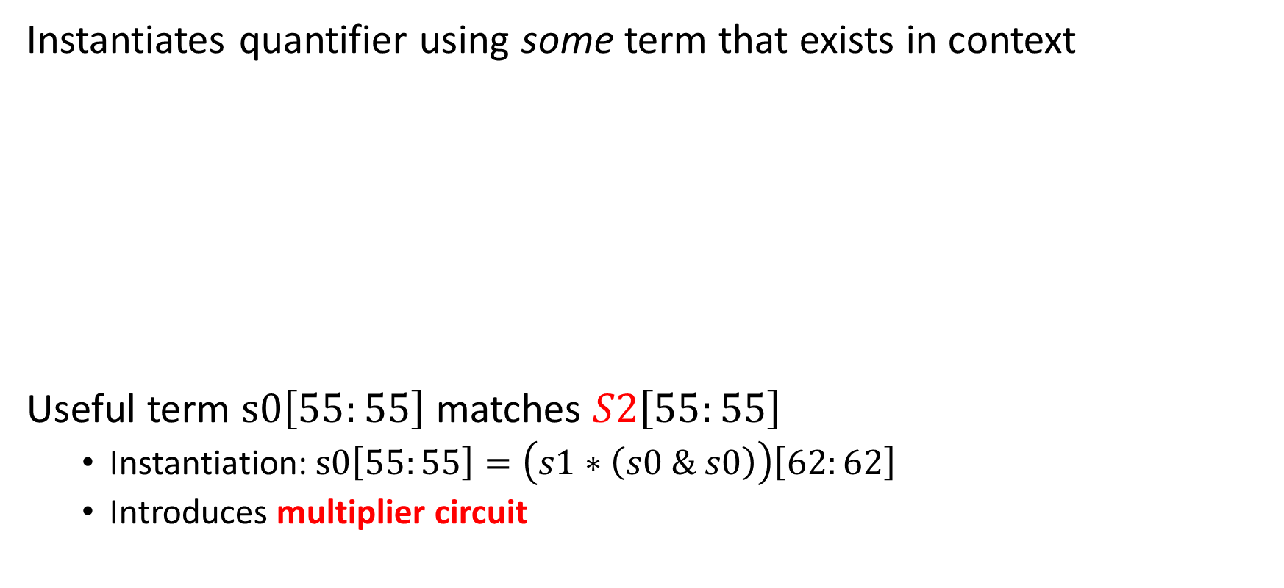
Retrieving information - Why not E-matching?
Instantiates quantifier using some term that exists in context
Useful term $s0\left[55:55\right]$ matches $S2\left[55:55\right]$
Instantiation: $s0\left[55:55\right]=\left(s1∗\left(s0 \& s0\right)\right)\left[62:62\right]$
Introduces multiplier circuit
$∀S2 . S2\left[55:55\right]=\left(s1∗\left(S2 \& s0\right)\right)\left[62:62\right]$
1 $=\left(s1 ∗concat\left(0, s0\left[55:55\right],0\right)\right)[62:62]$

Slide 27
Retrieving information
a₀∧b₃
a₀∧b₂
a₀∧b₁
a₀∧b₀
Bit-blasting, cost of multipliers
Multiplier circuits for 64 bits are super expensive
HA
a₁∧b₂
HA
a₁∧b₁
HA
a₁∧b₀
FA
a₂∧b₁
FA
a₂∧b₀
FA
a₃∧b₀
out₃
out₂
out₁
out₀

Slide 28
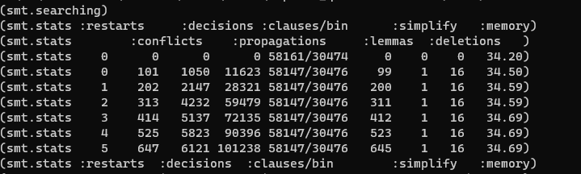
Retrieving information
Trying QSAT
QSAT solves satisfiability for nested quantifiers.
It works on top of bit-vectors
=> bit-vector multiplier circuit recompiled on every instantiation
(apply (then simplify qsat) :print_statistics true)

Slide 29
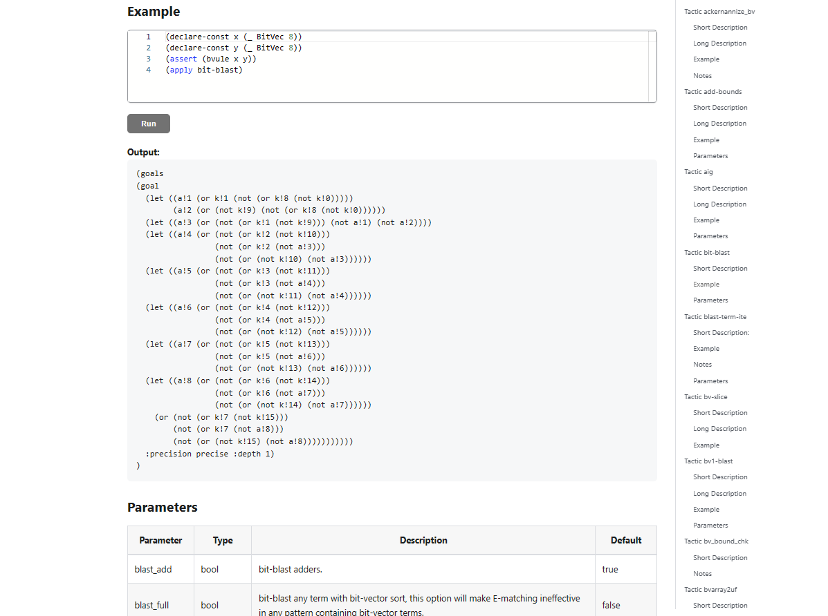
Skip repeated bit-blasting
(apply (then simplify
(with bit-blast :blast_quant true)
qsat) :print_statistics true)
The problem is now pure 2-QBF.
Option:
Feed output of tactic (w/o qsat)
to a dedicated QBF solver.
TODO

Slide 30
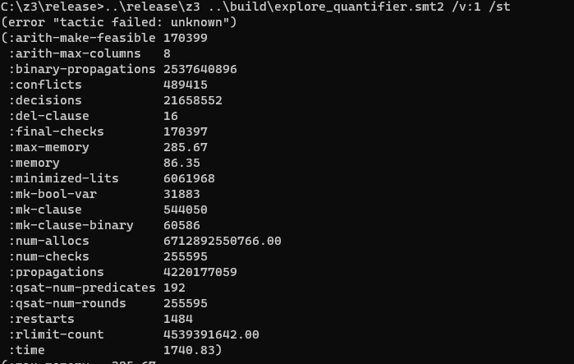

The magic didn’t happen
(apply (then simplify
(with bit-blast :blast_quant true)
qsat) :print_statistics true)
But MBQI also works with bit-blasted:
(check-sat-using (then
simplify
(with bit-blast :blast_quant true)
smt) :print_statistics true)

Slide 31
Revising hypotheses
Was this rewrite the real culprit?
~x = -1 – 1*x

Slide 32
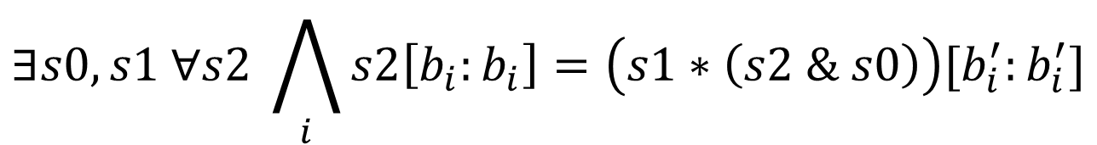
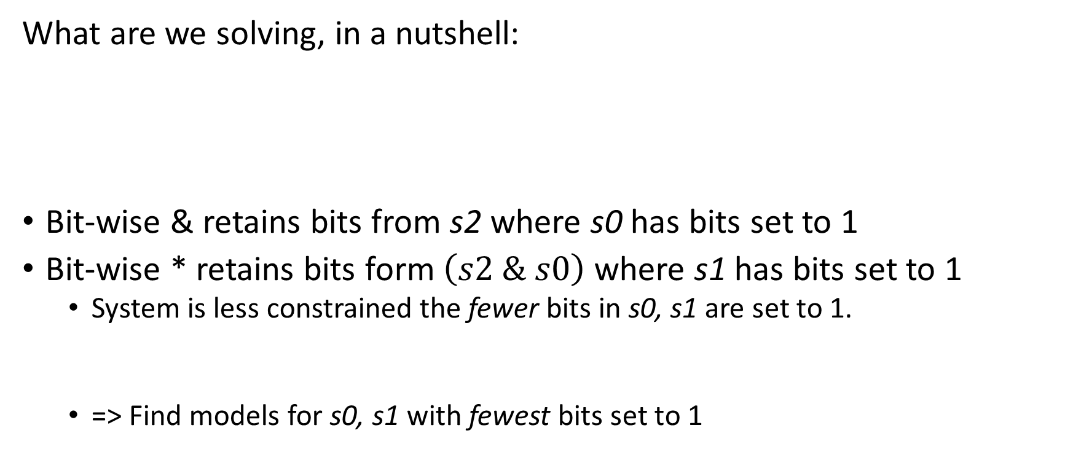
A domain Insight
What are we solving, in a nutshell:
Bit-wise & retains bits from s2 where s0 has bits set to 1
Bit-wise * retains bits form $\left(s2 \& s0\right)$ where s1 has bits set to 1
System is less constrained the fewer bits in s0, s1 are set to 1.
=> Find models for s0, s1 with fewest bits set to 1
$$∃s0,s1 ∀s2 \bigwedge_{i}{s2\left[b_{i}:b_{i}\right]=\left(s1∗\left(s2 \& s0\right)\right)[b_{i}^{′}:b_{i}^{′}]}$$

Slide 33
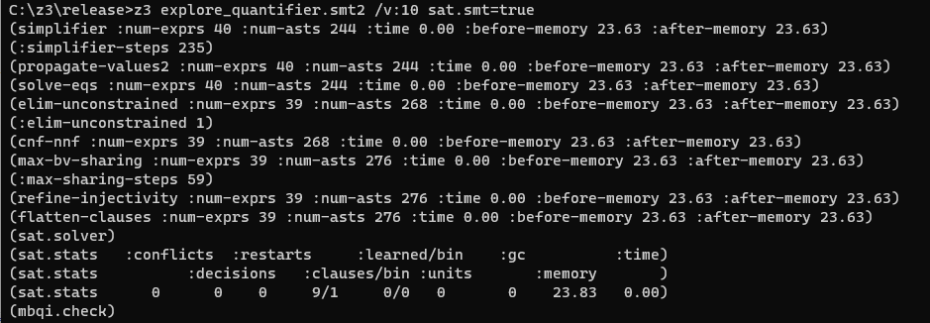
Retrieving information
Uses incremental pre-processing
tinkering with sat.smt=true
TODO

Slide 34
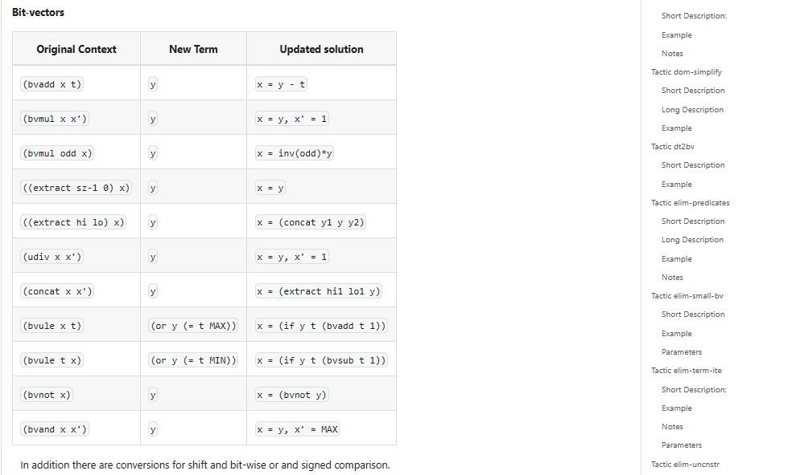
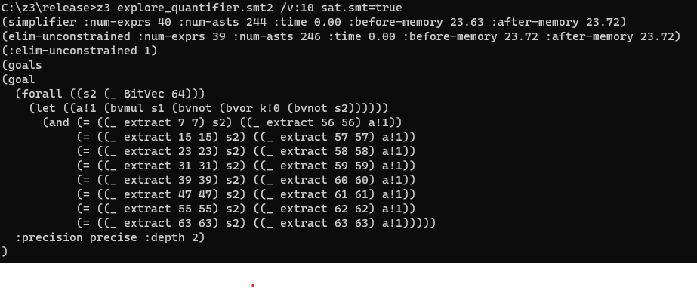
Retrieving information – digging into tactics
$∀s2 . s2\left[55:55\right]=\left(s1∗\left(\sim \left(\sim s2 \right|\sim s0\right))\right)\left[62:62\right]$
~s0 occurs in single position
Replace by fresh variable
Replaced by fresh variable

Slide 35

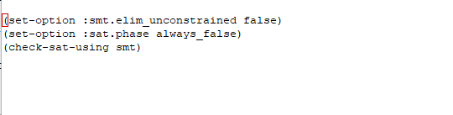
Retrieving information
After ~s0 was replaced by fresh variable k!0
Bits in k!0 are opposite polarity of s0
Branch ordering based on setting bits in inputs to 0 is broken!

Slide 36
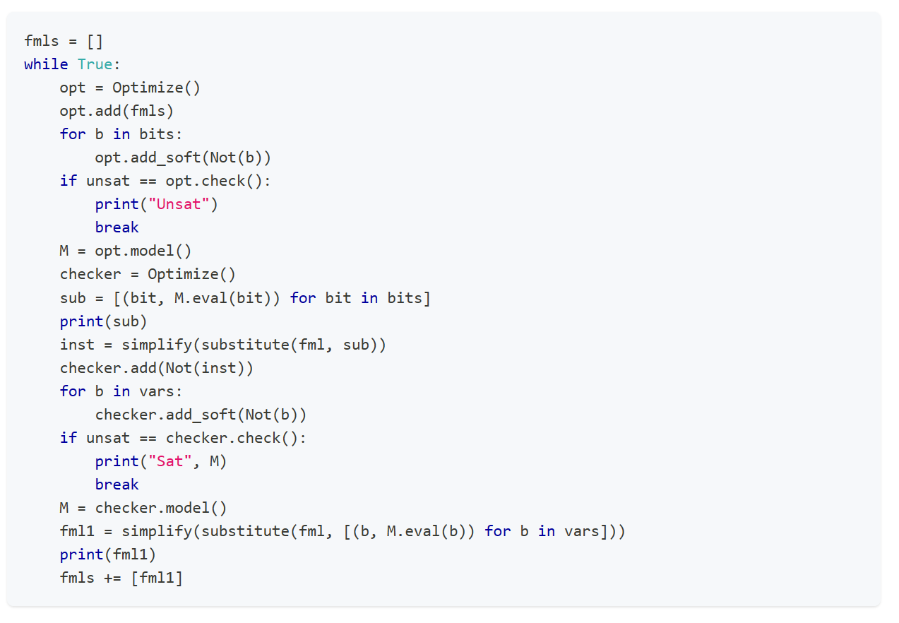
A custom MBQI with optimization
https://Microsoft.github.io/z3guide/programming/Example%20Programs/MBQI
Solves problem very quickly, no dependency on variable phases

Slide 37
Retrieving information - recap
Verbose mode
Statistics
Inspect result from pre-solve (apply simplify)
Instrument Clause Traces
Shape hypotheses, revisit them
Debug traces
Clause traces again

Slide 38
Encoding – generic rules
Introducing helpful predicates
Can a model capture the likes of Ackermann reductions, cuts?
Watch out for N x M overhead. Can you use functions?
CDCL(T) is just horrible at problems with symmetries.
More theories isn’t better. Common trap is mixing bit-vectors with ints.
Use succinct encodings when available, if not use quantifiers or Custom Theories
Break symmetries in encodings
Heed the cost of impure and mixed theories

Slide 39
Encoding – The power of SAT solvers (?)
Z3 is more stable for unsatisfiable problems than satisfiable problems.
Partial control by using knobs such as smt.phase_caching_on=80000, sat.threads=4
CDCL is horrible at xor reasoning. By nature, CDCL SAT searches for regular resolution proofs.
There are no existing knobs to make xor work, but a CryptoMiniSAT T-solver in the works.
SAT is a solved problem, right?

Slide 40
Encoding – CDCL(EUF)
Shifting reasoning about uninterpreted functions to the CDCL SAT core can produce significant speedups
The CDCL core has no E-node overhead, learns strong lemmas
The CDCL core does not scale with encodings that grow by cross-products
Shifting reasoning about uninterpreted functions to the CDCL SAT core is not practical for large formulas

Slide 41
Controlling Search
Z3 does not use cores unless you ask it to
You can parallelize z3 in several ways
parallel.enable=true (cube and conquer)
Solver is super sensitive to tradeoffs in time spent solving vs. cubes created.
sat.threads=4
Run parallel instances of sat core sharing clauses.
smt.threads=4
Run parallel instances of smt core run in multiple rounds using alternate see cubes
tactic.default_tactic=(then simplify (par-or (with smt :smt.random_seed 1) smt))
Parallel tactics, no sharing, no cubing.
Parallel Z3 doesn't offer any speedups
But don’t expect miracles..
you have to tune yourself

Slide 42
Tactics

Slide 43
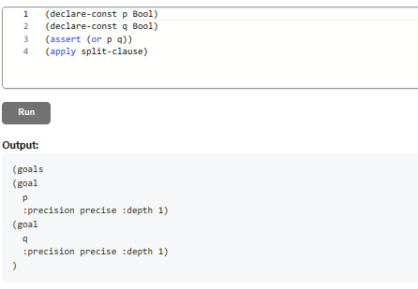
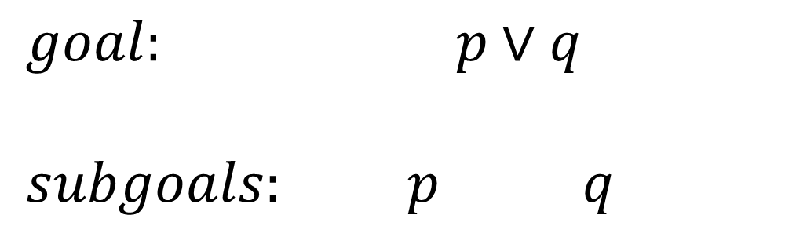
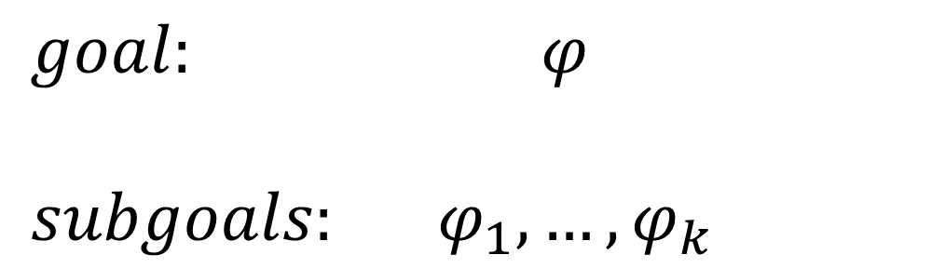
Tactics
$goal: φ$
${subgoals: φ}_{1},…, φ_{k}$
$goal: p∨q$
${subgoals: p q }_{}$
Model of one subgoal converts to model of original goal
Proof of all subgoals convert to proof of original goal

Slide 44
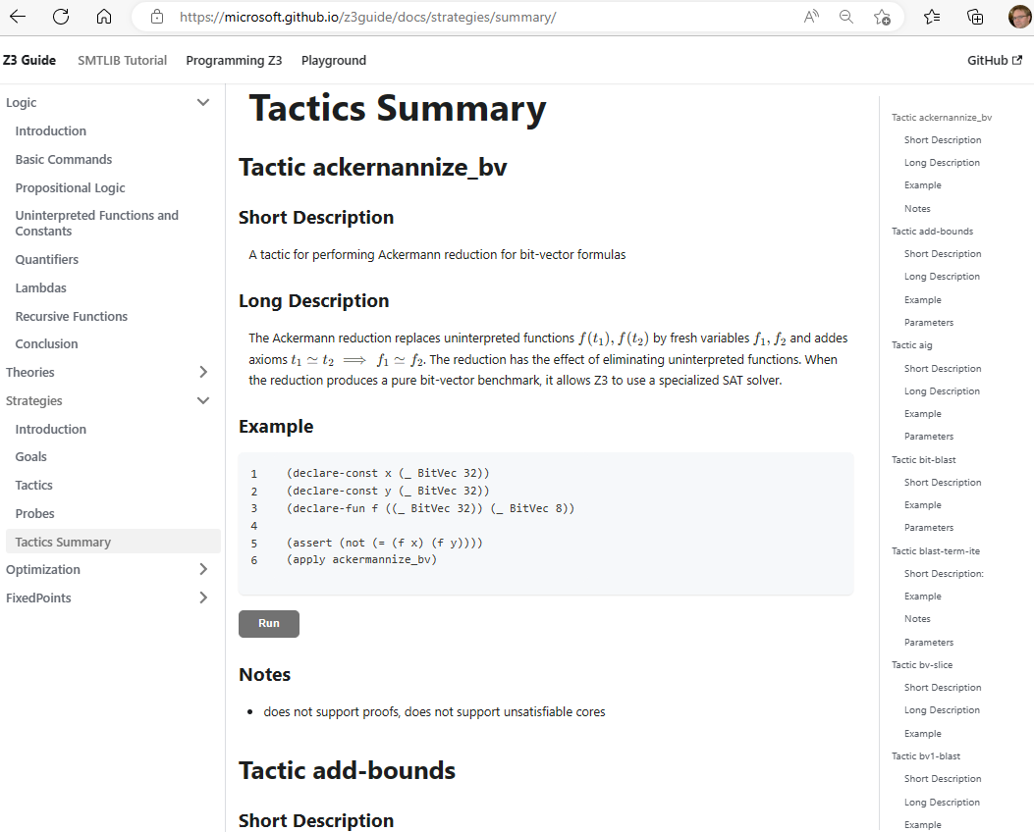
Tactics Online

Slide 45

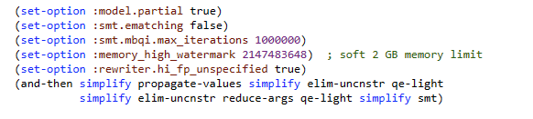
Tactics – Use case in Alive2
C, C++, ObjC, Rust,
Swift, …
frontend
llvm2alive
static unroll
encode semantics & refinement check
LLVM IR
Alive2 IR
Alive2 IR
LLVM middle-end optimizers
SMT formulas
LLVM IR
Alive2 IR
Alive2 IR
clang, rustc, etc
LLVM
Alive2
UNSAT or partial model
Alive2 tactic

Slide 46
Tactics – Use case Alive2
Alive2 formulas:
bit-vectors, arrays, lambdas, floating-point numbers, EUF, quantifiers
Use only “hardened tactics” for production
Respect memory limits
Always simplifying
Simplifications enable new simplifications
same tactics run multiple times

Slide 47
Tactics –which tactics to use?
A1: it is an “experimental science”
A2: built-in tactics may be classified according to attributes
General
Translations
Theory Specific
nnf
tseitin-cnf
bvarray2uf
bt2bv
eq2bv
card2bv
lia2card
lia2pb pb2bv
fm
purify-arith
bit-blast
Contracting
Expanding
simplify
propagate-values
elim-uncnstr
solve-eqs
qe-lite
qe
blast-term-ite
Reduce Array to EUF
Reduce Arith to finite domains
cxt-simplify
ctx-solver-simplify

Slide 48
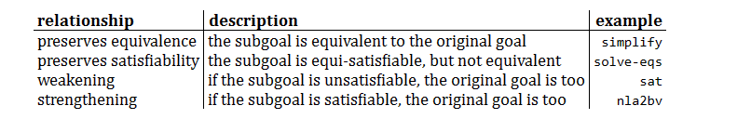
Tactics – classification by truth-preservation

Slide 49
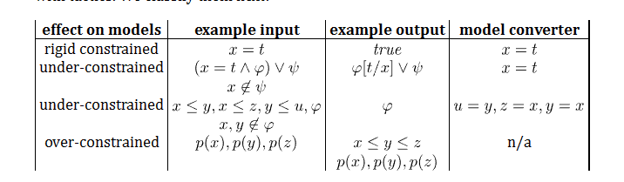
Tactics – classification model preservation
Upcoming functionality: Rigid and under-constrained tactics can be used for incremental solving

Slide 50
Solver Engines
CDCL(T) SPACER NLSAT QSAT

Slide 51
Satisfiability Modulo Theories (SMT)
Is formula ϕ satisfiable modulo theory T ?
SMT solvers have specialized algorithms for T

Slide 52

overview

Slide 53

CDCL(T)
Theory
Solvers
SMT
SAT
Equality + UF
Arithmetic
Bit-vectors
…
Case Analysis

Slide 54







CDCL(T)
x ≥ 0, y = x + 1, (y > 2 ∨ y < 1)
$$α$$
$$p1, p2, (p3  p4)$$
Strengthen
($¬p_{1}∨¬p_{2}∨¬p_{4})$
SAT
Block
$$p1, p2, ➢p3, p4$$
$$p1, p2, p4$$
$$γ$$
$$α$$
Theory Conflict
x ≥ 0, y = x + 1, y ≤ 1, y < 1
x ≥ 0, y = x + 1, y < 1

Slide 55


CDCL(T) – Main State Variables
Search State
$$⟨M;F⟩$$
$$⟨M;F;C⟩$$
Conflict State
F – set of clauses
Split into irredundant and redundant clauses.
Redundant clauses can be garbage collected.
2 literal watch list and binary clause optimization
M – a trail of assigned literals
C – a conflict clause

Slide 56


CDCL(T) - Invariants
M
F
$$C$$

Slide 57
CDCL(T) – Dual Model/Proof search
Backjump
Models
literal assignments
Proofs
Conflict Clauses
Conflict Resolution
Propagate

Slide 58



Dichotomy – Proofs and Models
Farkas Lemma
There is an $x$ such that: $Ax=b∧x≥0$
There is a $y$ such that: $yA≥0∧yb<0$
For every matrix $A$, vector $b$ it is the case that
either (1) or (2) holds (and not both).
From DPLL to CDCL
There is $M′⊇M$ such that $M′⊨F$
There is$M′⊆M$ and proof $Π$ such that $F⊢_{Π}\overline{M\text{′} }$
Given $M$ can it be extended to $M$’ to satisfy (1)?
If not, find subset $M′$ to establish (2).
(that is inconsistent with F)
Corollary
Conflict learning (resolution)
extends F by clauses that block shorter models
If $M ⊨¬F$ then
- $\overline{C,ℓ }⊆M$ for some $F⊢C∨ℓ$ (or $F$ contains $∅$)
- for every $D$, where
- $\overline{D},\overline{C} ⊆M^{′}⊆M$,
- $M^{′}⊢(D∨¬ℓ)$
it is not possible to extend${ M}^{′}$ to satisfy $F$

Slide 59

CDCL(T) as inference rules

Slide 60

CDCL(T) – SAT vs SMT
SAT engine
Truth assignment is symmetric for Boolean variables
Probing (for failed literals)
L is failed if asserting L & F infers false by unit propagation.
Cost of propagation controlled by clause watch list
Boolean Variables are fixed during search
“Fast restart” introduced to prioritize variables used in conflicts
SMT engine
Truth values of Booleans are not independent
$x≤0, x≤1$ are dependent
Cost of propagation depends on theories
Quantifier instantiation, theory lemmas introduce fresh literals (all the time)
Fast restarts appears likely not a great idea

Slide 61

CDCL – CaDiCaL loop

Slide 62

CDCL(T)

Slide 63
Solver Internals

Slide 64


Terms and Formulas
de Bruijn index
Terms are hash-consed
let t = App(f,args) let t’ = termTable[t] mkApp(f, args) = if t’ = nil then termTable[t]$←t$; t else t’

Slide 65


Assertion Internals
(assert (! p :named q))
SMT2 file
assert_and_track(p, q);
API
$$⟨φ=p, π=assume\left(p\right), δ=q⟩$$
Pre-processing simplification
Tactics
Core uses
dependencies
Solver
Transformed Assertions
Proof uses justifications

Slide 66



From Assertions to Solver State
$$x≥0 ∨ (p∧q\left(x\right))$$
Clauses
$\left(1 2\right) \left(1 3\right)$
$1↦x≥0, 2↦p, 3↦q(x)$
$n_{23}:⟨f=x,args=ε,$ $P=\left[n_{27}\right],$ $th=\left[\left(arith, 4\right)\right]⟩$
bool_var2expr
expr2enode
z3 search.smt2 /tr:euf tactic.default_tactic=smt sat.smt=true

Slide 67






Core $↔$ Solver interface
CDCL
EUF Core
Solver
$n_{23}:⟨f=x,args=ε,$ $P=\left[n_{27}\right],$ $th=\left[\left(arith, 4\right)\right]⟩$
$n_{25}:⟨≥, args=ε,$ $$boolVar=1, \\ th=[\left(arith,5\right)]$$
$$assigned\left(ℓ@1\right)$$
$$propagate\left(x≥0@5, Explain\right)$$
Dispatch Theory Solver
$$propagate\left(ℓ, Explain\right)$$
$$propagate\left(n≃n′, Explain\right)$$
Does not participate in congruence closure
Theory variable

Slide 68


Custom Theories

Slide 69





Model-based Theory Combination
$$x=f\left(z\right), f\left(x\right)≃f\left(y\right), 0≤x≤1, 0≤y≤1, z=y −1$$
$x= ⋆_{1}y= ⋆_{2}z= ⋆_{3}$ $x=1, y=1, z=0$
$f\left(⋆_{1}\right)= ⋆_{1}f\left(⋆_{2}\right)= ⋆_{2}f\left(⋆_{3}\right)=⋆_{1}$
Create fresh literal $x≃y$
Case split on $x≃y←⊤$
Conflict, backtrack $x≠y$
$$x=f\left(z\right), f\left(x\right)≃f\left(y\right), 0≤x≤1, 0≤y≤1, z=y −1,x≠y$$
Create fresh literal $x≃z$
Case split on $x≃z←⊤$
$$x≃z$$
$x=0 y=1, z=0$
$x= ⋆_{1}y= ⋆_{2}z= ⋆_{1}$
$f\left(⋆_{1}\right)= ⋆_{1}f\left(⋆_{2}\right)= ⋆_{2}$

Slide 70

Relevancy Filtering
Purpose: expose only subset of literal assignments to T solvers
Reason: Delays introduction of terms for T-and quantifier instantiation
Idea: Simulate tableau reasoning on top of CDCL
$$(\left(a∧b\right)∨c)$$
$\left(\left(a∧b\right)∨c\right) (¬\left(a∧b\right)∨a)$ $\left(¬\left(a∧b\right)∨b\right)$ $\left(\left(a∧b\right)∨¬a∨¬b\right)$
Root clause
Definition clauses
Scenario 1: c is assigned to T, root clause is satisfied. Atoms $\left(a∧b\right), a, b$ are never set relevant
Scenario 2: c is assigned to F, $\left(a∧b\right)$ is assigned T. Atoms $a, b$ are marked relevant (and propagated to T)
smt.relevancy={0,1,2} (least to most use of relevancy filter)

Slide 71


Ackermann reductions
smt.dack.threshold = 10, smt.dack.eq = false

Slide 72

Iterative Deepening
Assume ((_ is nil) list1) ((_ is nil) list2)
Unsat core: ((_ is nil) list1)
Assume ((_ is nil) (tail list1)) ((_ is nil) list2)
Unsat core: ((_ is nil) list2)
Assume ((_ is nil) (tail list1)) ((_ is nil) (tail list2))
Unsat core: ((_ is nil) (tail list1))
Assume ((_ is nil) (tail (tail list1))) ((_ is nil) (tail list2))
SAT

Slide 73
Core Decision Procedures

Slide 74

overview

Slide 75
CDCL(T)

Slide 76
Custom Theories

Slide 77
Classification
TODO
Arrays
Finite Domains
ADTs
EUF
Arithmetic
Hybrid
str.len, bv2nat
User-Propagator

Slide 78


Finite Domain Theories

Slide 79
Finite Domains and CDCL(T)
Compile to SAT Compile to SAT + E Word level

Slide 80

Finite Domains and CDCL(T)
$$p+q+r≤1∧ \\ (u⇒(p∧q)+(p∨q)+r≥2)$$
Compile to CDCL
Compile to CDCL + PB propagation

Slide 81

EUF

Slide 82





EUF
$$a = f(f(a)), a = f(f(f(a))), a  f(a)$$
Produce Proofs
Incremental Updates
Propagate Literals
$a =v_{2}, a =v_{3}, a  v_{1},$
$v_{1}≡f\left(a\right), v_{2}≡f\left(v_{1}\right), v_{3}≡f(v_{2})$
$a, v_{2}, v_{3}$
$$v_{1}$$
Union Find
Step 1: Equivalence classes from equalities
$a, v_{2}, v_{3}, v_{1}$
Step 2: Apply Congruence Rule:
$a≃v_{2}$ implies $f\left(a\right)≃f\left(v_{2}\right):{ v}_{1}≃v_{3}$
E-graph

Slide 83

EUF – data-structure

Slide 84






EUF – union-find w. path compression, siblings
Z3 uses path compression to ensure roots are within a single hop of find
Maintain separate singly linked cyclic list of siblings
$$a≃f(c)$$
$$b≃c$$
$$c≃f(c)$$
a
a
b
b
$$b≃c$$
$$a≃f(c)$$
f(b)
f(b)
f(c)
f(c)
c
c
$$cc:f(b)≃f(c)$$

Slide 85


EUF - internalize
$$f(g\left(a\right), g\left(a\right), a)$$
Terms are “hash-consed”
Roots are initialized to self
etable: $[a↦n_{1},g\left(\left[n_{1}\right]\right)↦n_{2}, f\left(\left[n_{2},n_{2},n_{1}\right]\right)↦n_{3}]$

Slide 86












EUF - merge
$$a = f(f(a)), a = f(f(f(a))), a  f(a)$$
$$n_{2}: f(a)$$
$$n_{3}: ff(a)$$
$$n_{4}: fff(a)$$
$$n_{1}:a$$
$${merge(n}_{1},n_{3})$$
$etable\left[f,n_{1}\right]←null$ (since $n_{2}∈n_{1}.P)$
$$n_{1}.find←n_{3}$$
$$n_{2}: f(a)$$
$$n_{3}: ff(a)$$
$$n_{4}: fff(a)$$
$$n_{1}:a$$
($n_{2}∈n_{1}.P)$
$n_{2}.cg←etable[f, {root(n}_{1})]=$ $n_{4}$
$add \left\langle n_{2},n_{4}\right\rangle$ to tomerge

Slide 87









EUF - Justifications
a
b
Union – find link
$$a≃f(c)$$
$$b≃c$$
Justification link
f(b)
f(c)
c
$$cc:f(b)≃f(c)$$
a
After merge
$$c≃f(c)$$
b
$$a≃f(c)$$
$root\left(c\right)←root(f\left(c\right))$
Justification path from
old root(c) to c got reversed
$$b≃c$$
f(b)
f(c)
$$cc:f(b)≃f(c)$$
c
$$c≃f(c)$$

Slide 88

EUF - internals
Nodes from Boolean literals contain fields:
value : { true, false, undef}
boolVar : a number referring to Boolean variable as known by SAT solver
Equality nodes are special: When n1, n2 are merged, the parent n5 is equality, value = false -> conflict
$$a  f(a)$$
$n_{5}=⟨≃, [n_{1},n_{2}], \left(n_{5},n_{5},1\right), P=ε, cg=n_{5},j=nil, value=false, boolVar=27⟩$

Slide 89
EUF – internals: equalities and values
Values: If a node comes from a term that denotes a value (5, 42, 2/3, cons(1,nil)), it is always a root
When two roots with terms based on different values are merged -> conflict
Who reasons about equalities of Booleans? EUF vs. CDCL
E-nodes based on Bool do by default not merge with other nodes.
Default is overridden if E-node occurs under a non-connective.
E-graph propagates equalities to theories and Booleans to SAT
$n_{5}=\left\langle ≃, \left[n_{1},n_{2}\right], \left(n_{5},n_{5},1\right), P=ε, cg=n_{5},j=nil, value=undef, boolVar=27\right\rangle$
$n_{1}.find←n_{2}$ -> value is set to true and assignment to boolVar 27 is propagated to CDCL core

Slide 90
Quantifiers

Slide 91



E-Matching
$\begin{matrix} & p_{(∀…\text{)}} \\ ∧ & a=g\left(b,b\right) \\ ∧ & b=c \\ ∧ & f\left(a\right)≠c \\ ∧ & p_{(∀x\text{ ...)}}→f\left(g\left(b,b\right)\right)=b\end{matrix}$
$$\begin{matrix} & (∀x f\left(g\left(c,x\right)\right)=x\text{)} \\ ∧ & a=g\left(b,b\right) \\ ∧ & b=c \\ ∧ & f\left(a\right)≠c \\ ∧ & \left(∀x f\left(g\left(x\right)\right)=x\right)→f\left(g\left(b,b\right)\right)=b\end{matrix}$$
$g\left(c,x\right)$ matches $g\left(b,b\right)$ with substitution $\left[x↦b\right]$ modulo $b=c$
[de Moura, B. CADE 2007]

Slide 92









E-Matching
Match $g\left(c,x\right)$
Match $c$ $root\left(b\right)= c$
Match $x$ $x↦b$
$\begin{matrix} & p_{(∀…\text{)}} \\ ∧ & a=g\left(b,b\right) \\ ∧ & b=c \\ ∧ & f\left(a\right)≠c \\ ∧ & p_{(∀x\text{ ...)}}→f\left(g\left(b,b\right)\right)=b\end{matrix}$
$$c$$
$$g(b,b)$$
$$b$$
$$a$$
$$g(b,b)$$
$$b$$
$$b$$

Slide 93







E-Matching
Match $g\left(c,x\right)$
Match $c$ $root\left(b\right)= c$
Match $x$ $x↦b$
Match $x$ $x↦d$
$$c$$
$$g(b,b)$$
$$g(b,d)$$
$$b$$
$$a$$
$$g(b,b)$$
$$g(b,d)$$
$$b$$
$$b$$
$$d$$

Slide 94



E-Matching
Match $g\left(c,x\right)$
Match $c$ $root\left(b\right)= c$
Match $x$ $x↦b$
Match $c$ $fail$
$$c$$
$$g(b,b)$$
$$g(d,b)$$
$$b$$
$$a$$
$$g(b,b)$$
$$g(d,b)$$
$$b$$
$$b$$
$$d$$

Slide 95

E-Matching
Matching against an E-graph is
Not unitary (more than one match)
Is NP hard $t≃¬f, f≃¬t, t≃t∧t, t≃t∨f, t≃f∨t, t≃t∨t$ $t≃\left(X∨¬Y∨Z\right)∧\left(Z∨¬X∨U\right)∧…$
Minimize incremental work after a new merge
Reuse work when processing multiple patterns
Partial evaluation and run-time code specialization

Slide 96

E-Matching using code-trees

Slide 97

E-Matching priorities
$$∀xψ$$
$$x↦g(b)$$
w$=3$
∀𝑥𝜓
𝑥↦𝑔(𝑏)
w=3
$$∀xφ$$
$$x↦g(h(c))$$
$$W=1, \\ gen=2$$
∀𝑥𝜑
𝑥↦𝑔(ℎ(𝑐))
𝑊=1, 𝑔𝑒𝑛=2
$$∀xθ$$
$$x↦h(c)$$
$$W=1$$
∀𝑥𝜃
𝑥↦ℎ(𝑐)
𝑊=1
$$∀xφ \\ x↦h\left(c\right) \\ weight=1 \\ generation=1$$
∀𝑥𝜑 𝑥↦ℎ(𝑐) 𝑤𝑒𝑖𝑔ℎ𝑡=1 𝑔𝑒𝑛𝑒𝑟𝑎𝑡𝑖𝑜𝑛=1
Quantifiers with instances are inserted into a heap
score := (+ weight generation)
weight: annotation on quantifier
generation: number of instantiations used to produce binding
Heap is consumed
During propagation if: score $≤\text{smt}\text{.}\text{qi}\text{.}\text{eager}\text{_}\text{threshold}$
Otherwise at final check if: score $≤\text{smt}\text{.}\text{qi}\text{.}\text{lazy}\text{_}\text{threshold}$

Slide 98

MBQI: Model based Quantifier Instantiation
[de Moura, Ge. CAV 2008]
[Bonacina, Lynch, de Moura CADE 2009]
[de Moura, B. IJCAR 2010]

Slide 99

MBQI – outline of approach

Slide 100

Quantifier Elimination / Satisfiability
Presburger Arithmetic, Algebraic Data-types,
Quadratic polynomials
SMT integration to prune branches
[B. CADE 2010, B. Janota LPAR 2015]

Slide 101






QSAT
$$F_{j−1}←F_{j−1}∧∃{x_{j}(F}_{j }∧ x_{≤j} = M(x_{≤j}))$$
$Q_{j−1}$
find model for $F_{j}∧ x_{≤j−1 } = M(x_{≤j−1})$
$Q_{j}$
unsat
fix $x_{j} = M(x_{j})$
sat
find model for $F_{j+1 }∧ x_{≤j} = M(x_{≤j})$
$$Q_{j+1}$$

Slide 102

MBP

Slide 103

MBP – model-based projection
$(M\left(y\right)=y)⇒Projection⇒∃x…$:
Finite set of projections for $∃x…$
Dual projection $∀x…$ used to close case splits during search
Model is used for free variables (value of x is not needed in procedures)

Slide 104
MBP – theories
LRA, LIA, NRA
Term algebras (disunification)
Some cases with arrays
Bit-vectors (z3 currently bit-blasts)

Slide 105


Slide 106
Theory Solvers

Slide 107
Arithmetic
SAT/SMT Backtracking
Search
Propagation
+ Conflicts
Assert bounds on integer/real variables
Solve for Reals Use Simplex to find solutions to constraints + bounds
Bounds propagation Infer equalities and bounds from existing bounds
Solve for Integers
Cube
GCD test
Branch and Bound
Hermite Normalize
Gomory Cuts
Solve for multiplications
Bounds propagation
Horner expansion
Gröbner solving
Incremental linearization
NL-SAT
SAT

Slide 108





Arithmetic – Linear Programming
Input formula
Bounds added during search
$$x≥0, s_{1}≤2, s_{1}≥2$$
Internal representation
$s_{1}≡x+y, s_{2}≡x+2y$
$$x≥0, \left(s_{1}≤2∨s_{2}≥6\right), \left(s_{1}≥2∨s_{2}>4\right)$$
Pivot and change values to satisfy bounds
$$y=s_{1}−x, s_{2}=−x+2s_{1}$$
$s_{1}=2, y=2, x=0, s_{2}=4$
Initial tableau and values
$$s_{1}=x+y, s_{2}=x+2y$$
$$s_{1}=x=y=s_{2}=0$$

Slide 109






Propagating Equalities
SAT/SMT Backtracking
Search
$$x=z$$
$$x+1=y$$
Assert bounds on integer/real variables
$$y −1=z$$
Complete method [Bromberger & Weidenbach]:
1. Turn $≥$ into $>$ on asserted bounds.
2. If new inequalities are infeasible, then $≥$ can be strengthened to $=$ in minimal unsat core.
Bounds propagation Infer equalities and bounds from existing bounds
$$\underline{x+1=y y −1=z}$$
$$x=z$$

Slide 110




Propagating Equalities
Equality inferences require addition/subtraction operations
Asserted inequalities
$x+u≤z z −1≤y y≤x 1≤u≤1$
$$\underline{x+1=z z −1=y}$$
$$x=y$$
How the solver sees the constraints
$x+u+s_{1}=z z −1+s_{2}=y y+s_{3}=x 1≤u≤1 0≤s_{1} 0≤s_{2} 0≤s_{3}$
After pivoting
$$x=z−u −s_{1} y=z −1+s_{2} s_{3}={−s}_{2}− {u+1− s}_{1} 1≤u≤1 0≤s_{1} 0≤s_{2} 0≤s_{3}$$
After propagating bounds on $s_{1}, s_{2},s_{3}$
$$x=z−u −s_{1} y=z −1+s_{2} s_{3}={−s}_{2}− {u+1− s}_{1} 1≤u≤1 0≤s_{1}≤0 0≤s_{2}≤0 0≤s_{3}≤0$$
Subtract first two equalities to infer
$$x=y$$
Subtle complexity: Every row can have many fixed variables. Adding values of constant bounds requires significant runtime.

Slide 111




Propagating Equalities - efficiently
$$\underline{x=z−u −s_{1} y=z −1+s_{2} 1≤u≤1 0≤s_{1}≤0 0≤s_{2}≤0 0≤s_{3}≤0}$$
$$x=y$$
Instead of adding up rows to prove implied equality
Use fact all variables have values assigned by Simplex solver
Then two variables are equal if
They are connected through offset equalities
They have the same value
offset equality
$$x=y+{\underset{{b_{1}≤z}_{1}≤b_{1}, { b}_{2}≤z_{2}≤b_{2},}{\underbrace{{a_{1}z}_{1}+a_{2}z_{2}+…}}}_{}$$
Example: If solver assigns $x=3$ then $z=4, y=3$
$x, y$ are connected (over $z−1$).
$x, y$ have the same value (3)

Slide 112




Arithmetic – Integers
Cube
GCD test
Unit Cube fits
$⇒$ Integer solutions are guaranteed
5 + 3y + 6z = 0
Has no integer solution because 3$⊥$ 5
Branch and bound
Cut
$LP solver:x ≔1.5$
Create case split: $x≤1$
Z3 knows : $¬\left(x≤1\right)≡x≥2$
[copied from Duterte, de Moura SRI TR]

Slide 113
Arithmetic – Integers
In scope
Bounds propagation to CDCL
Equality propagation to T
Modeling at level of SMT
Out of scope
Finite domains
Weak cuts
Incomplete for mixed-Integer
Modular arithmetic and LP

Slide 114





Arithmetic – Non-linear
Non-linear bounds
Gröbner
Factoring and equality propagation
$$xy=0∧xyz+u−v=0⇒u=v$$
Solving (based on variable ordering)
$$x+p=0∧x^{2}q+r=0⇒p^{2}q+r=0$$
Result of GB used for bounds propagation
$$0≥x≥−2∧ 0≤ y≤ 3⇒ x⋅y≥ −6$$
$$0≥x≥−2∧ 0≤ y≤ 3⇒ x⋅x⋅y≤ 12$$
Polynomials as
Multi-terminal ZDDs
Based on implied bounds
Incremental Linearization
NLSAT
$$0≥x≥−2∧ 0≤ y≤ 3⇒ x⋅y≥ −6$$
$$0≥x≥−2∧ 0≤ y≤ 3⇒ x⋅x⋅y≤ 12$$
(how it is staged?)
Based on current values for x, y

Slide 115
Arithmetic – Non-linear
In scope
Bounds and Equality propagation
Polynomials over reals (low degree)
Out of scope
Polynomials over integers
Exponentiation
Trigonometric functions
Indefinite operations
summations/products/integrals

Slide 116


Arrays
Reducible | reduce to base theories
Compile into EUF
UNSAT

Slide 117


Arrays
Reducible | reduce to base theories
Convert EUF solution to
solution over arrays
Compile into EUF

Slide 118

A Solver for Unicode Characters
Unicode Theory
$⟨U, ≤,=:U×U→Bool⟩$ $\left|U\right|=196608$
Operator $≤$ is used sparingly
So common case is theory of $=,≠$
Engine: Union-find + Lazy reduction to bit-vectors
Inferior alternatives: pure bit-vectors, linear arithmetic, difference arithmetic

Slide 119

A Solver for $⟨U, ≤,=:U×U→Bool⟩$ $\left|U\right|=196608$
Equality
Union Find
a
b
c
d
e
s
t
a = b, b = c, d = e, b = s, d = t, a≠ e, a≠ s
a,b,c,s
d,e,t

Slide 120
A Solver for $⟨U, ≤,=:U×U→Bool⟩$ $\left|U\right|=196608$
Equality
Union Find
a
b
c
d
‘e’
s
‘t’
a = b, b = c, d = ‘e’, b = s, d = ‘t’, a≠ e
a,b,c,s
d,’e’,’t’

Slide 121




A Solver for $⟨U, ≤,=:U×U→Bool⟩$ $\left|U\right|=196608$
$$a≤b$$
Inequality
Bit-blasting
$\left(a\left[17\right]→b\left[17\right]\right)$
$∧\left(\begin{aligned}(a\left[17\right]↔b\left[17\right])→ \\ a\left[16:0\right]≤b\left[16:0\right]\end{aligned}\right)$
$$a\left[17:0\right]≤b\left[17:0\right]↔$$
$$⋮$$
$$a\left[0:0\right]≤b\left[0:0\right]↔\left(a\left[0\right]→b\left[0\right]\right)$$

Slide 122



A Solver for $⟨U, ≤,=:U×U→Bool⟩$ $\left|U\right|=196608$
Combining two views
$$a=b$$
$$a≤b$$
Equality View
Bit-Blast View
$$⟨U, ≤,=:U×U→Bool, bv2char :Bool^{18}→U,$$
$$\left[0\right]:U→Bool, \left[1\right]:U→Bool, …, \left[17\right]:U→Bool⟩$$
This solver
$$bv2char\left(a\left[17\right], …, a\left[0\right]\right)=a$$
Bit-vector solver

Slide 123
Custom Theories

